Slide 1


SEICHE 2022 Introduction to Arduino Lesson 4 and 5– IDE Essentials
Instructor: Paul Frommeyer
www.paulfrommeyer.com
Corporate Sponsor: DXC Technology

Slide 2
REMEMBER!
Immediately copy the latest lesson folder (Lesson6 today) from your USB flash drive to your hard drive where you previously copied the other flash drive files (probably Documents folder)

Slide 3
Lesson Plan Overview
Lesson 1 – Intro and Setup
[may require 2 classes]
• Introduction to class format
• Overview of lesson plan
• Presentation format (monitor, camera, screen, whiteboard)
• Inventory of Arduino kits
• Inventory of USB drives
• Installation of ESP32 serial port drivers (Windows only)
• Installation of Arduino software
• History of Computing
Lesson 2 and 3 – Laptop operation review
• Control panel/Settings location
• Home directories and folder hierarchy
• Arduino file locations
• Search functions
• Open questions and issues
• History of Computing redux
Lesson 4 and 5 – IDE essentials
• The boards manager
• Setting board type
• Installing Libraries
• Loading example sketches
• Finding and selecting the Arduino USB port
• Uploading a sketch to the microcontroller [Example Sketch#1]
• Basic Arduino sketch (program) structure
• Uploading your own sketch [Example Sketch #2]
• History of Telecommunications and Networking – Part 1
Lesson 6 – DC Electricity Basics and DMM Intro
• Quick review: DC vs AC electric currents
• DC current operation
• Voltage vs Amperage (current)
• Ohm’s Law
• Series vs parallel circuits
• Introduction to basic DMM functions and usage
• Measuring voltage [DMM usage #1]
• History of Telecommunications and Networking – Part 2
Lesson 7 – Elementary Components
• Resistors [DMM usage #2]
• Diodes and LED’s [DMM usage #3]
• Powering LEDs and dropping resistors
• Capacitors: Electrolytic (polarized) vs non-electrolytic (non-polarized)
• Simplified transistor operation
• Connecting an LED to a microcontroller [Class Sketch#1]
• Connecting a transistor to a microcontroller [Class Sketch #2]
• History of Telecommunications and Networking – Part 3
Lesson 8 – ESP32 External power sources [may require 2 classes]
• Microcontroller board power requirements
• Board power input options
• Components with different voltage requirements
• External power circuit design
Lesson 9 – Connecting LED’s to the ESP32 controller board
• Microcontroller pinouts and diagrams
• Different types of pins
• Analog input
• Digital Input and digital output
Lesson 10 – Connecting smart LED strips
• Simplified serial communication protocols
• One-wire serial communication protocol
• Hardware vs software serial
• WS2812B and Neopixel connections
• External device power design
Lesson 11 – Connecting LCD and Matrix Displays
• The SPI serial protocol
• SPI connections
• SPI device external power design
Lesson 12 – Connecting Sensors [Time permitting]
• I2C serial protocol
• I2C connections
• I2C sensor board power design and external power
Lesson 13 – Connecting other sensors [Time permitting]
• Connecting buttons
• Connecting potentiometers
• Reading buttons
• Reading potentiometers

Slide 4
Lesson 6 – DC Electricity Basics
Alternating vs Direct Current
Direct Current Operation – Classical Current
Voltage and Amperage – Water Analogy
Ohm’s Law
Ampacity, overloading, and current protection
Overvoltage and risks
Types of Electrical Loads
Series vs Parallel Circuits
Introduction to basic DMM functions and usage
Measuring voltage
History of Telecommunications and Networking P2

Slide 5
Ohm’s Law - Overview
An understanding of Ohm’s law is critical to working with microcontrollers and any circuits that use LED’s
E = IR
E = Electromotive Force
I = Intensity
R = Resistance
E = V = Volts
I = A = Amps
R = Ω = Ohms
The generic term for a device which consumes electricity in a circuit is a load
A no-load condition where electrons flow freely is called a short-circuit
Short circuits are damaging to power sources, conductors, or both

Slide 6
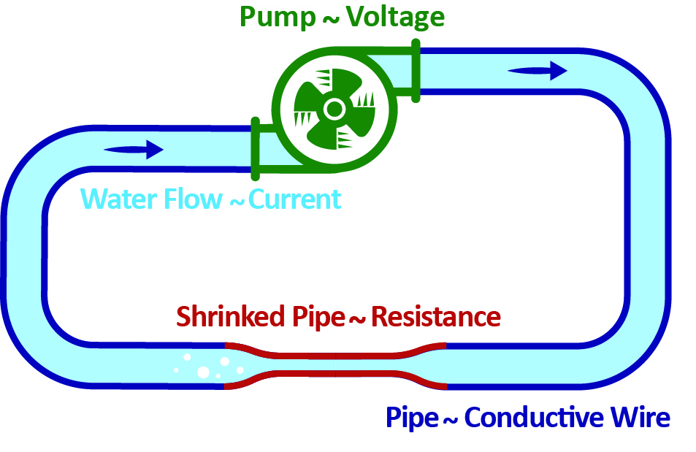
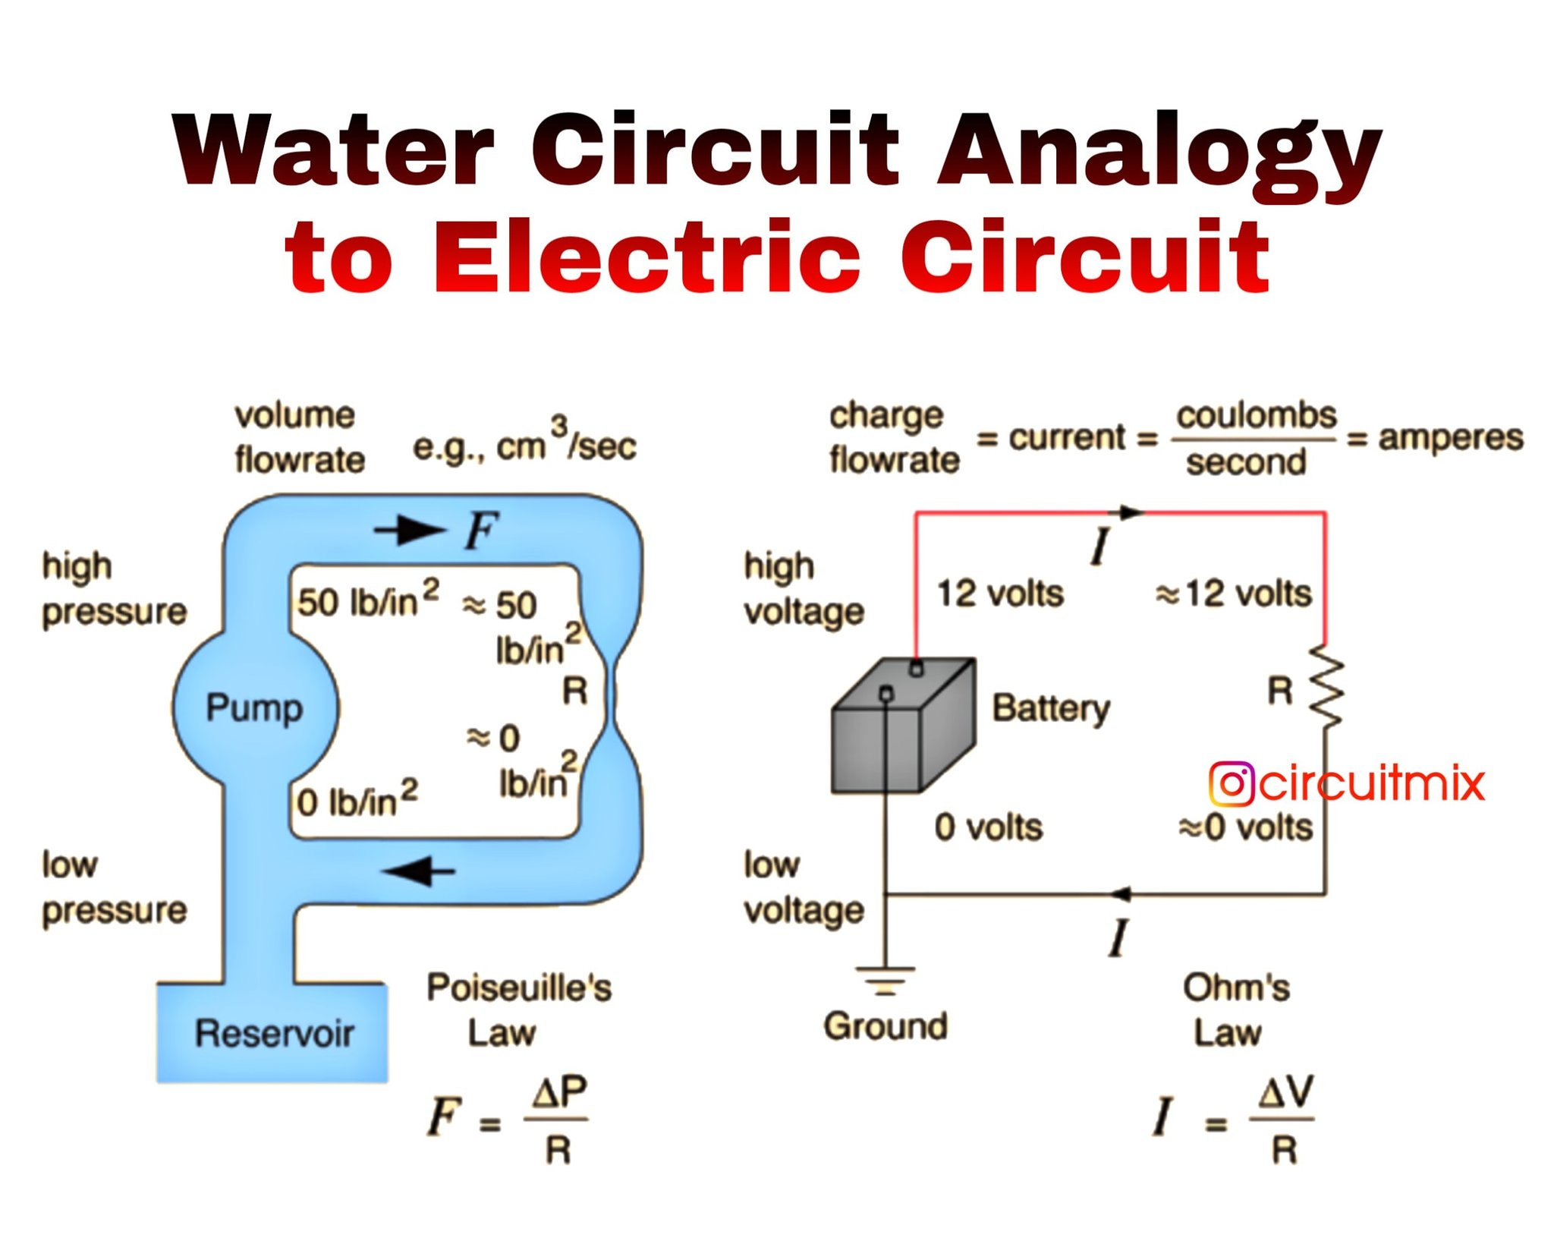
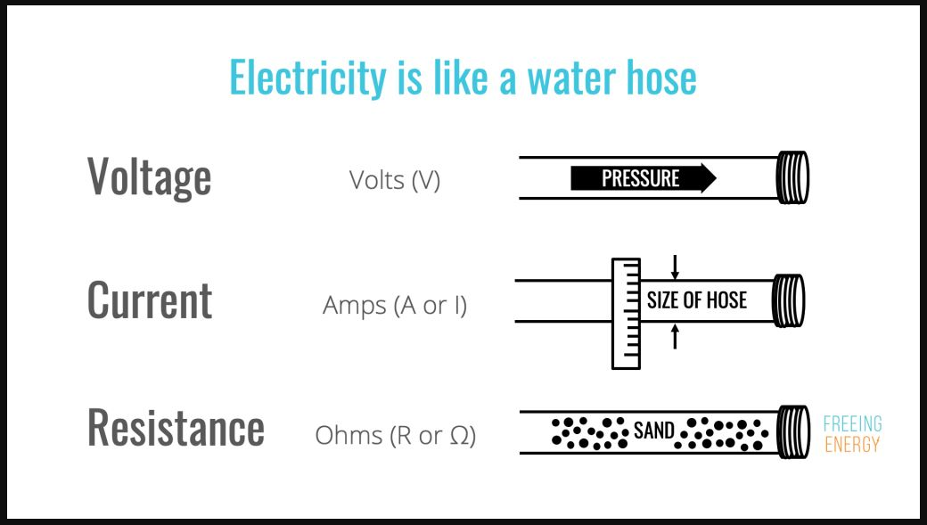
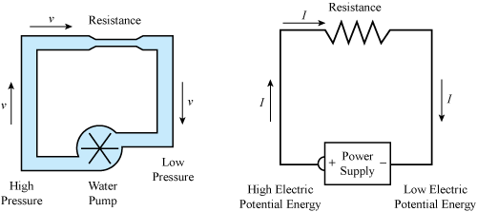
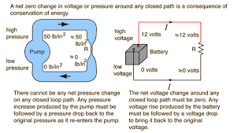
Ohm’s Law – Water Analogy
E = V = Volts
I = A = Amps
R = Ω = Ohms

Slide 7
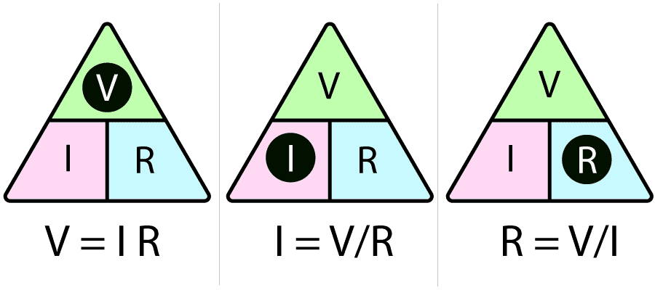
Ohm’s Law - Formulas
V = IR I=V/R R=V/I
Because Ohm’s law is an equation, we restate (reformulate) the terms to solve for whatever factor (value) is unknown. Thus, you must know two of the quantities to derive the third. The pyramid (above) is an easy visual way to determine which equation you need. An even easier way is with an app. ☺

Slide 8
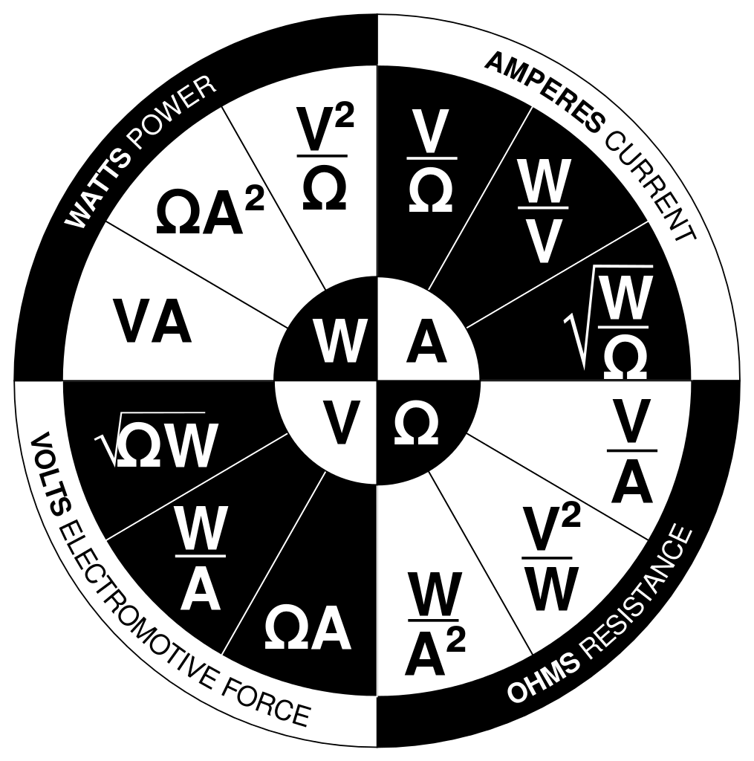
Ohm’s Law - Overview
You can also use the traditional four-factor wheel to solve for power, current, electromotive force, or resistance.
Power is determined by multiplying volts x amps. We pretend that this yields the power value in Watts, but watts may not match VA depending on the power factor– a complex concept that’s outside this class.

Slide 9
Ohm’s Law – Why Do We Care? - Ampacity
When electrons are blocked by resistance, it causes energy in the electrons to be lost. This energy is lost as heat (infrared electromagnetic radiation).
Resistance results whenever more electrons are forced through a conductor than the conductor can carry without loss (heating.)
The amount of current (amperage) that a given conductor can carry without excessive loss is called its ampacity.
When the ampacity of a conductor is exceeded, that conductor becomes a resistor. The greater the excess, the greater the resistance.
As you would expect, the greater the resistance, the greater the energy loss– and thus the more heat is generated.
This can be a feature (think hair dryer) or a hazard (see below.)
Exceeding the ampacity of a conductor is extremely dangerous. The conductor can heat to the point where a) the insulation catches fire, b) the conductor itself melts, or c) both. This is how electrical fires occur.

Slide 10
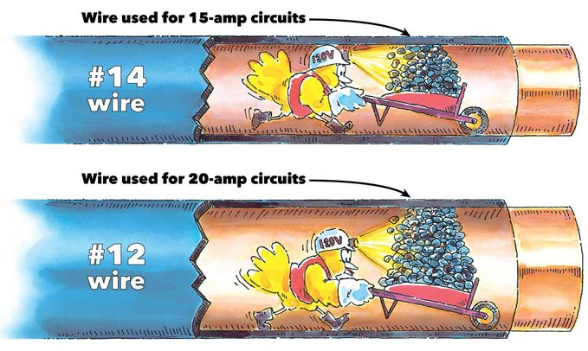
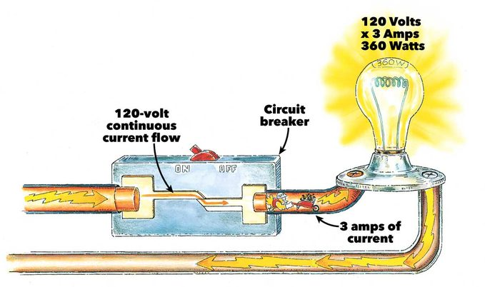
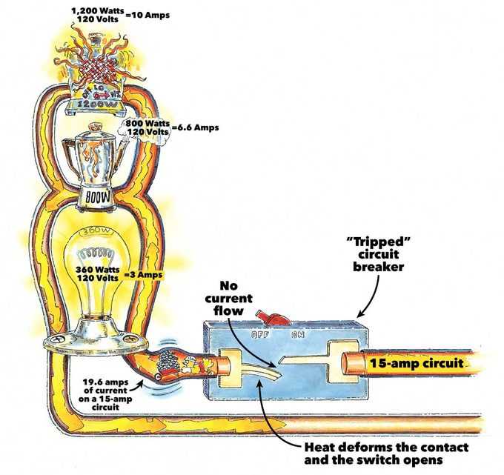
Ampacity – Sizing and Protection
Overcurrent protection is based on conductors heating up when overloaded
Circuit Breaker – Heating of the conductor temporarily breaks the circuit; usually needs manual reset
Fuse – Heating of the conductor melts it; it must be replaced
When there is no overload (which means, no heating), the circuit breaker stays closed, allowing electricity to flow
Wire is sized by gauge, and each gauge of wire has a specific ampacity [for copper or aluminum, respectively]
Ampacity is calculated based on summer temperature (90°F)
Wire gauge is inversely proportional to size, e.g., an 18 gauge wire is smaller than a 6 gauge wire.
You can use larger wire in place of smaller wire
Do not use smaller wire in place of larger wire
When there is an overload, the circuit breaker heats up, opening the circuit
Circuit breakers and fuses are sized to break the circuit BEFORE the conductor heats up to the point of damage – they have lower ampacity than the conductor they protect

Slide 11
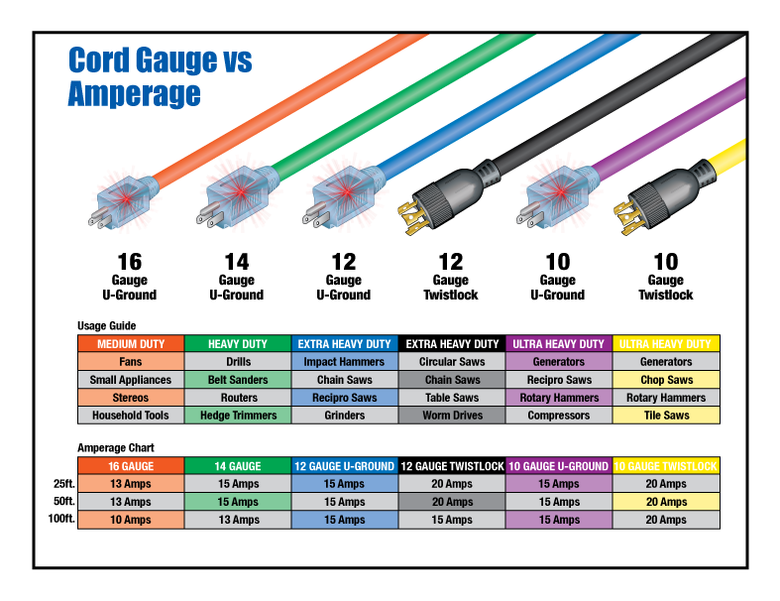
Ampacity – A/C Power Cordage
Always use a service cord with ampacity sufficient for the load
The longer a conductor is, the more resistance it has.
This reduces ampacity.
And that causes voltage drop for long conductors or any conductor with reduced ampacity

Slide 12

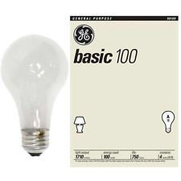
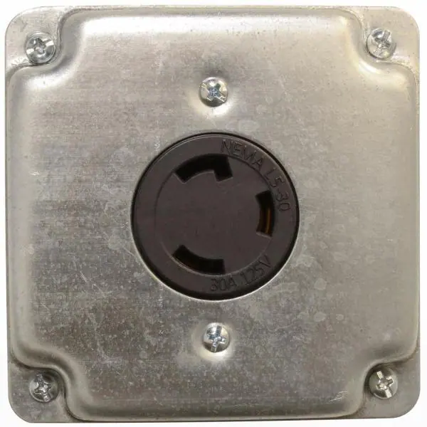
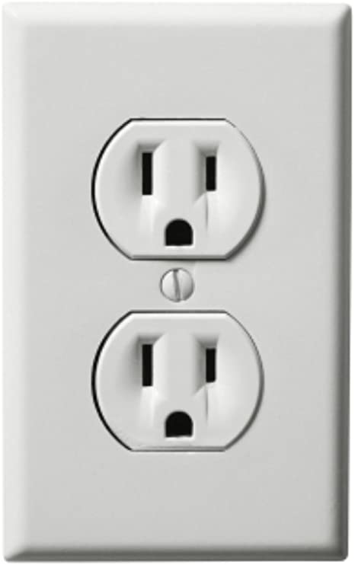
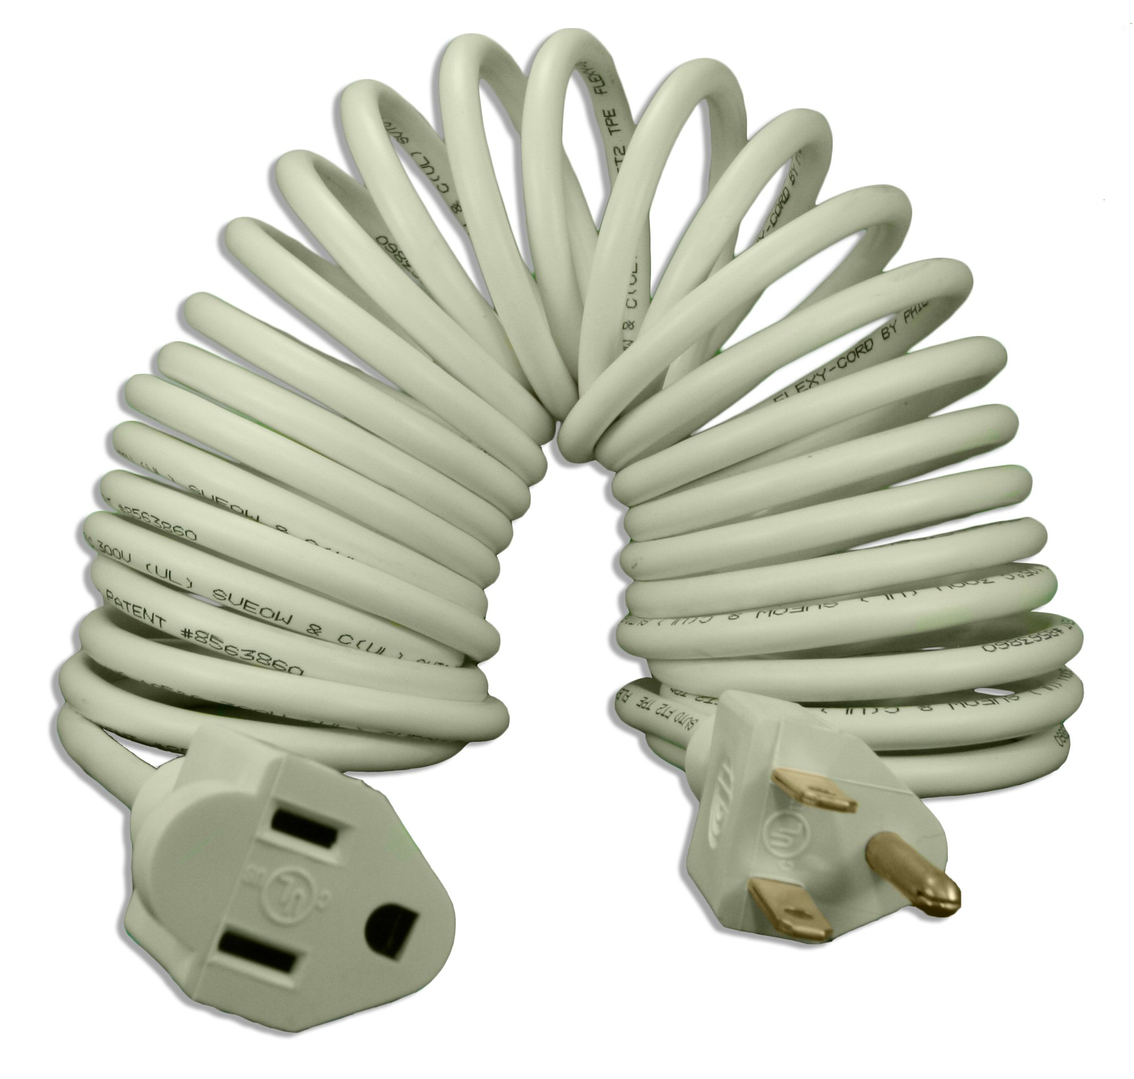
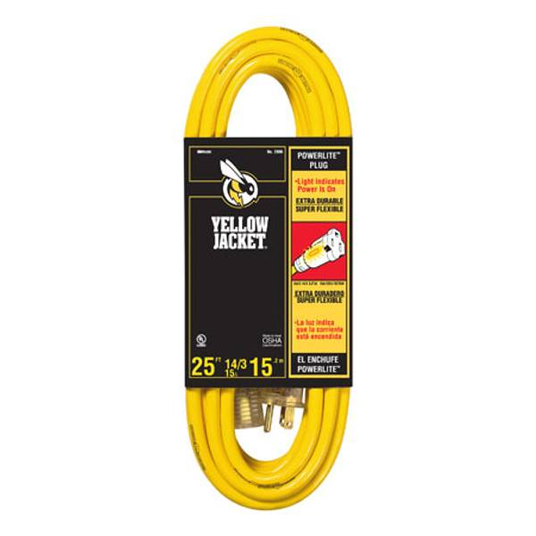
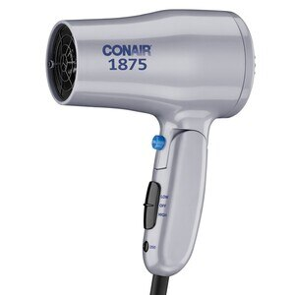
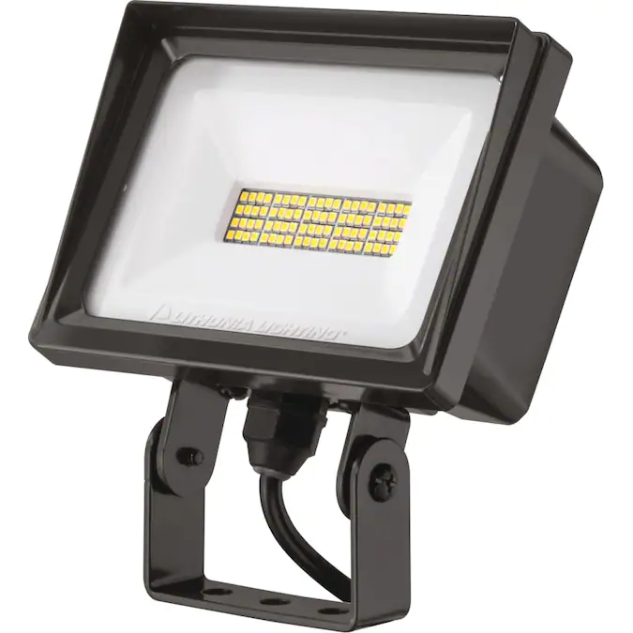
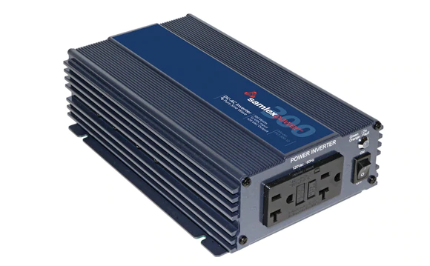
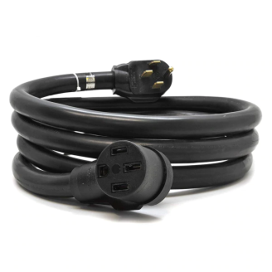
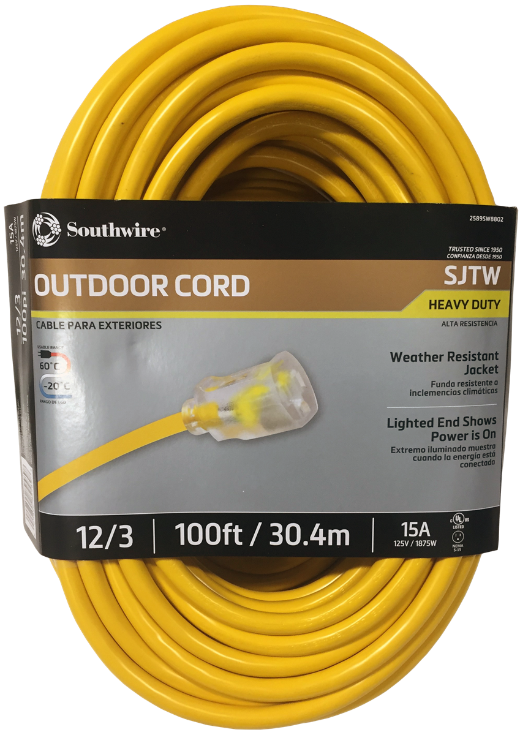

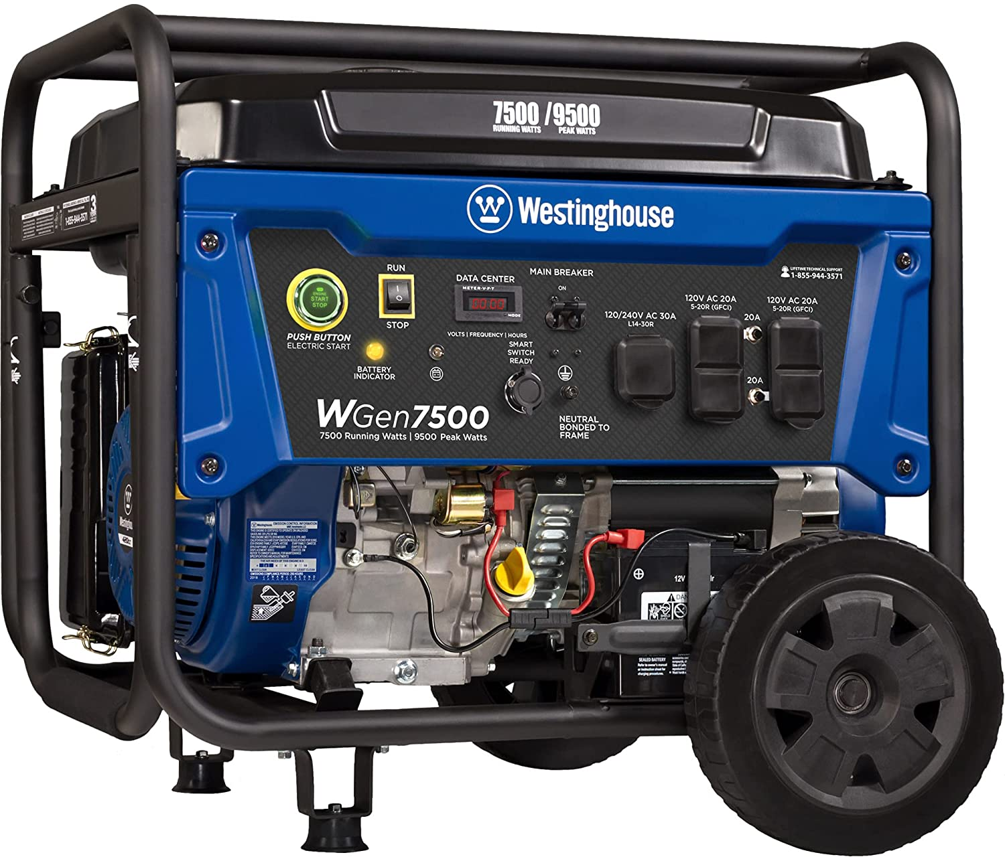

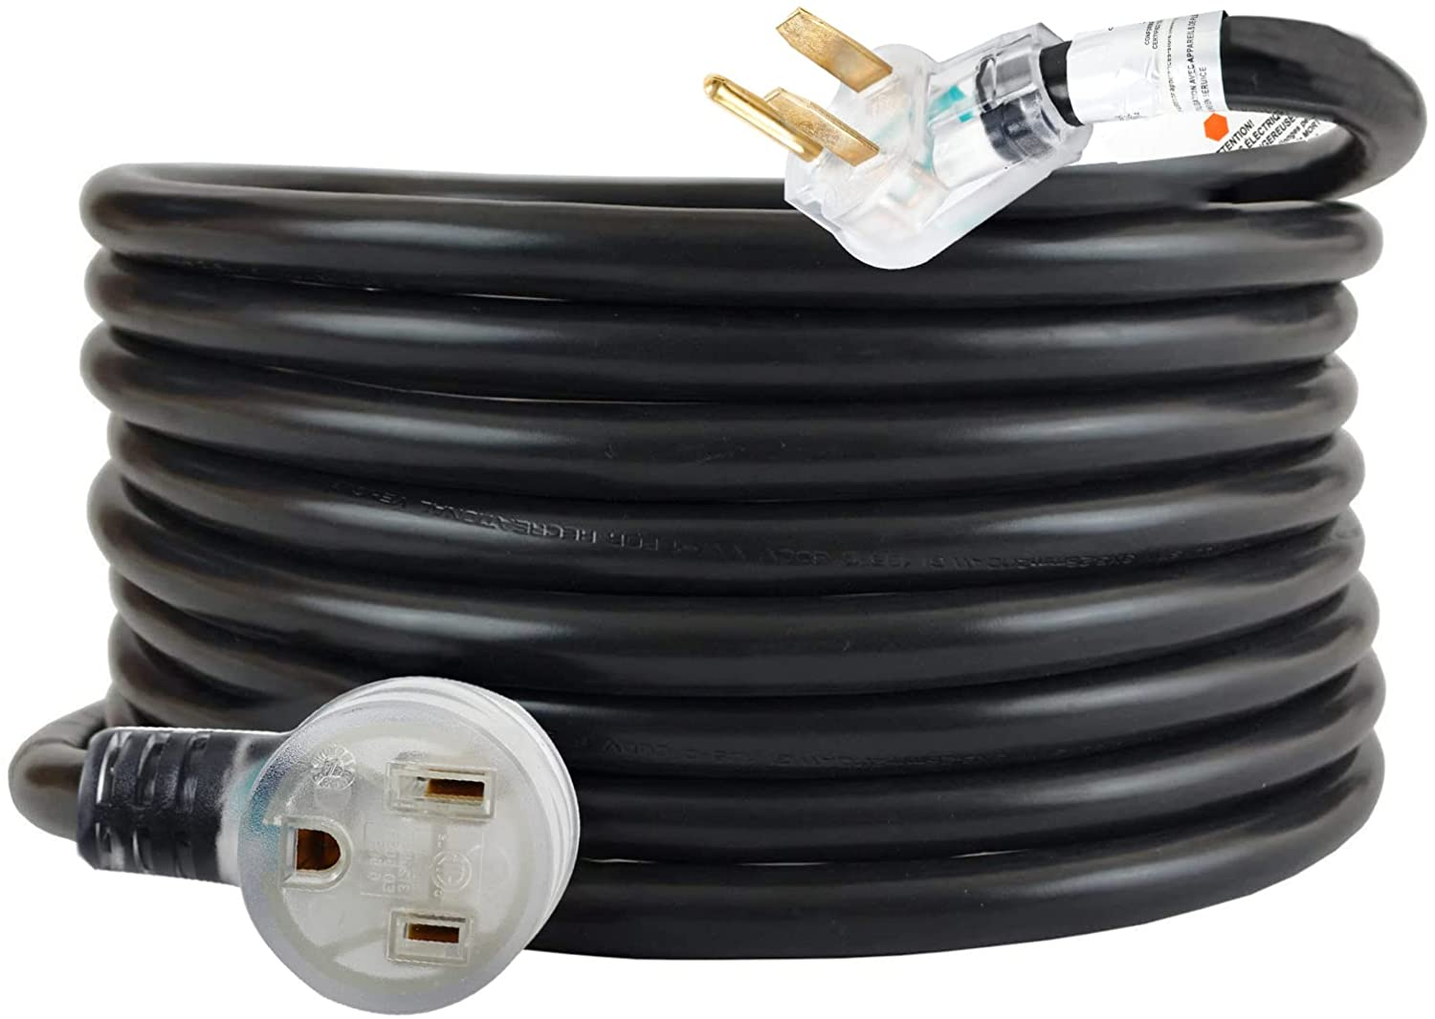
Ampacity – Test Your Knowledge!
Match the load with a service cord and power source!
Leaf Blower
900W
Light Bulb
100W
125V 30A
18ga 6ft
14ga 25ft
125V 15A
Hair Dryer
1875W
4000lm LED
200W
125V 2.5A
6ga 12ft
Induction Stove
4,000W
Gaming Tower
1,000W
10ga 25ft
12ga 100ft
125V/250V 30A

Slide 13
Ohm’s Law – Why Do We Care? - Voltage
It is normally* not possible for a consumer of electricity to exceed it’s own ampacity (as long as it’s working normally.) A device never uses more amperage than it needs. You can safely plug a 1,000 watt light bulb into a 120 volt, 15 amp circuit (which provides 1800 watts of power.)
*Not true for constant current devices, which have theoretically infinite ampacity
Voltage is another matter. Devices are design to operate at specific voltages, or ranges of voltage. Voltage outside the permitted value(s) will always cause the device to malfunction. High voltage will almost always destroy the device. Low voltage may cause little to no damage (electronics, resistive loads) or total burn out (motors, most other inductive loads.)
Connecting a device to a higher voltage than it is rated for will destroy it.

Slide 14
Ohm’s Law – Why Do We Care? - Arduino
Nearly all Arduino IDE compatible boards have on-board voltage regulators which will accept a range of low voltage DC current and change it into the fixed DC voltage needed by the board’s processor. That range is usually very narrow, and as covered previously board processor voltages are either 5 volts or 3.3 volts.
THERE IS NO OVERCURRENT PROTECTION FOR ELECTRONIC COMPONENTS
THERE IS NO OVERVOLTAGE PROTECTION FOR ELECTRONIC COMPONENTS
FAILURE TO CORRECLTY SIZE POWER DELIVERY AND USAGE CAN AND WILL DAMAGE MICROCONTROLLERS
THE AMOUNT OF CURRENT (AND VOLTAGE!) A GIVEN PIN CAN SOURCE OR SINK VARIES BY BOARD

Slide 15
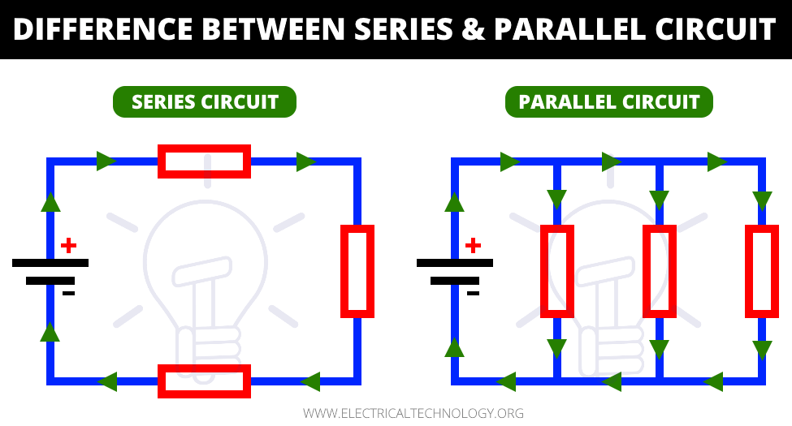
Types of Electrical Loads
Resistive – Generate some sort of heat during operation; usually, generating heat is the purpose of the device (e.g. hair dryer)
Inductive – Has a ferro-resonant electromagnetic component. Transformers and motors are the most common
Constant current – The device must be supplied with a constant amount of current. The device will act as a short circuit without a current limiting device in series with the load. This usually destroys the device before it destroys the power source.
Loads may be connected in series or in parallel.
Series
Resistance is additive
Single points of interruption/failure
Parallel
Amperage is additive
No single points of interruption/failure

Slide 16
Lesson 6 – Basic DMM Usage
Digital Multimeters (DMM’s) are used for measuring electrical flows
Voltage, amperage, and resistance are the most common measurements
Some DMMs have a continuity function which will sound a tone when a series circuit is complete with the DMM; this will also test diodes
Some DMMs can also measure frequency, duty cycle (percent of frequency), capacitance, inductance, and transistor operation
Some DMMs also have autoranging

Slide 17
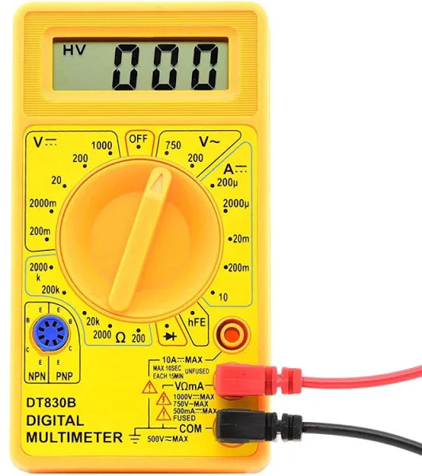
DMM Features and Functions
Display
DC Voltage Range
AC Voltage Range
DC Amperage Range
Selector Dial
Transistor Test
Resistance Range
High amperage + (red) jack
Diode/Continuity Test
Multifunction + (red) jack
Common (ground) – (black) jack

Slide 18
DMM Measurement
Polarity is important for all DC functions
Voltage is measured in parallel with electric circuits
Amperage must be measured in series with the electrical flow
Resistance is normally measured in series on a dead circuit
Resistance must never be measured on a live circuit; this will damage the multimeter
Continuity determines whether there is end-to-end conductivity
Because polarity matters, continuity also checks diodes

Slide 19
Let’s measure!
Plug in your 5VDC 2A power supplies
Assure the green barrel connector to screw terminal adapter is installed
Attach a red male-to-male DuPont jumper to the + screw terminal
Attach a black male-to-male DuPont jumper to the – screw terminal
Keep the bare ends of the jumpers apart!!!!!
Connect your alligator clip test leads to your multimeters (be sure black banana jack is plugged into the COM port on the meter!)

Slide 20
Let’s measure!
Set your DMM selector dial for 200VDC (always use a larger range when first measuring something)
Clip the red alligator clip to the red DuPont jumper
Clip the black alligator clip to the black DuPont jumper
Are you seeing anything on your meter?
Change the meter setting to 20VDC
What does your meter show now?

Slide 21
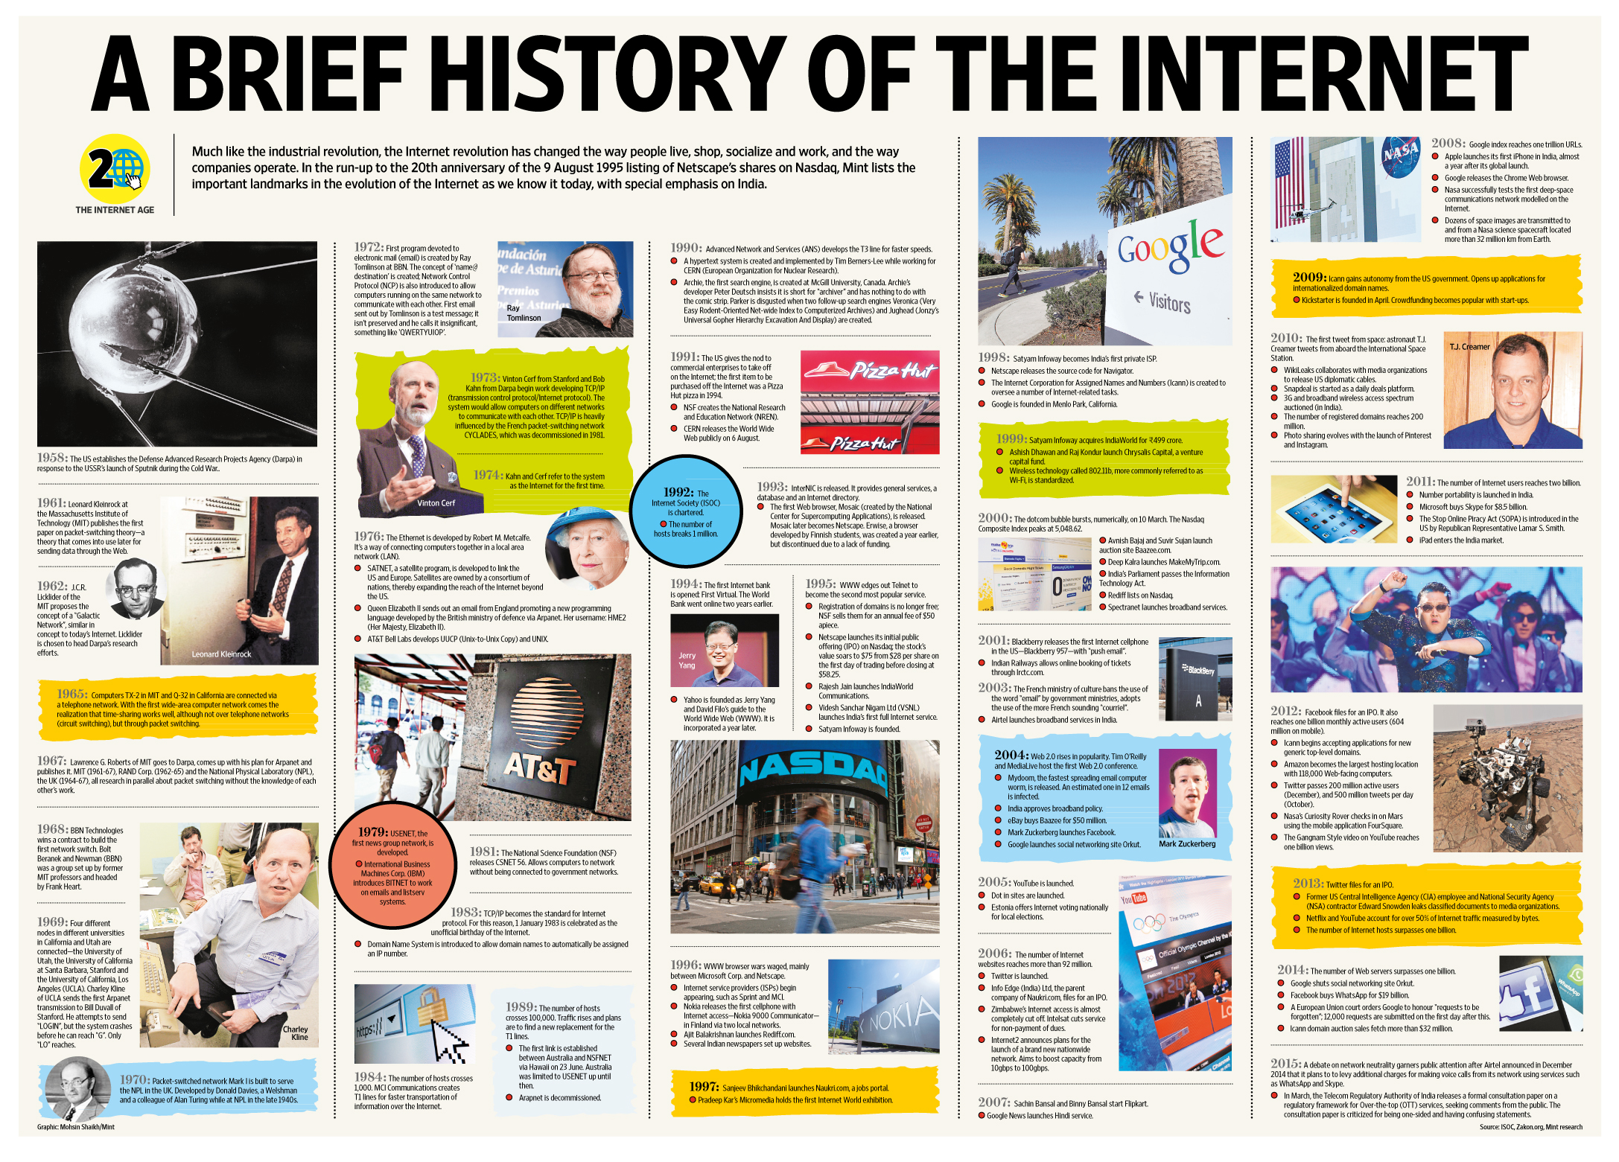
History of Telecommunications Part 2
The ISO/OSI model
Local Area Networks (LANs)
Wide Area Networks (WANs)
Wireless LAN (WiFi)
Cellular data networks
TCP/IP and the OSI model
The Rise and Fall of the Internet

Slide 22
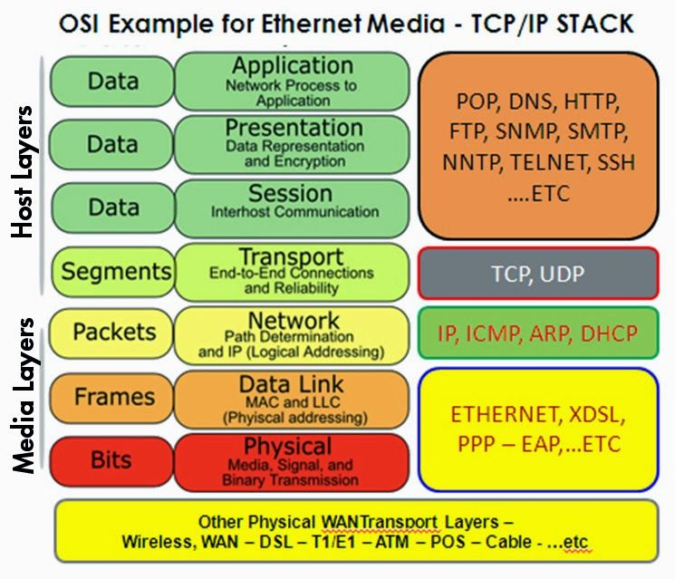
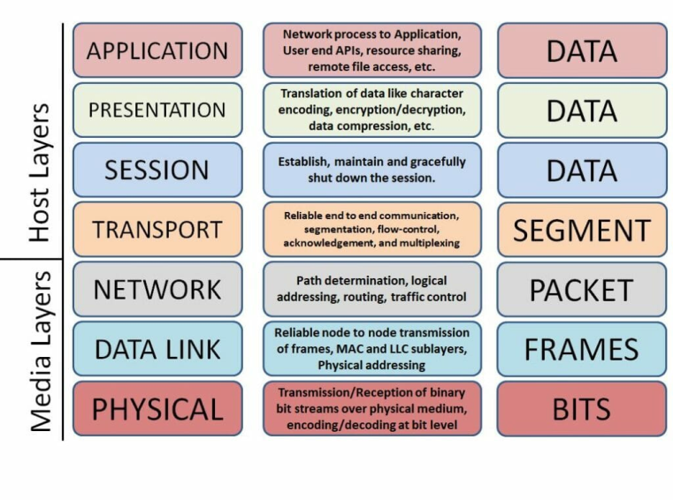
The OSI/ISO Layered Network Model
In a Quora post asking about the purpose of the OSI model, Vikram Kumar answered this way:
“The purpose of the OSI reference model is to guide vendors and developers so the digital communication products and software programs they create will interoperate, and to facilitate clear comparisons among communications tools.”
While some people may argue that the OSI model is obsolete (due to its conceptual nature) and less important than the four layers of the TCP/IP model, Kumar says that “it is difficult to read about networking technology today without seeing references to the OSI model and its layers, because the model’s structure helps to frame discussions of protocols and contrast various technologies.”
If you can understand the OSI model and its layers, you can also then understand which protocols and devices can interoperate with each other when new technologies are developed and explained.
Source: Network World

Slide 23
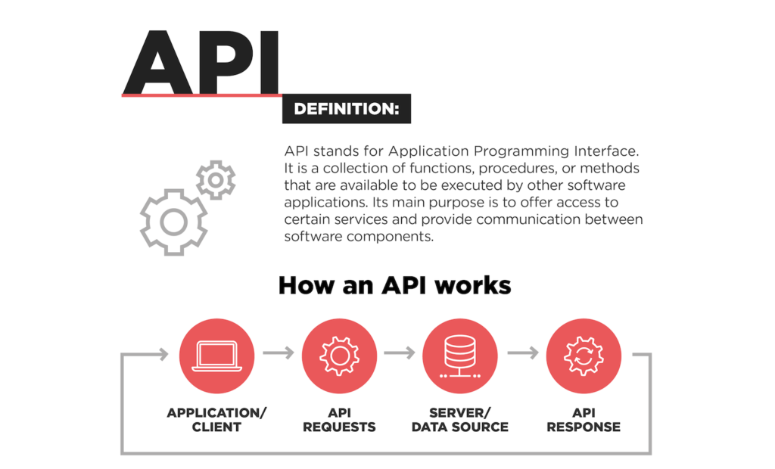
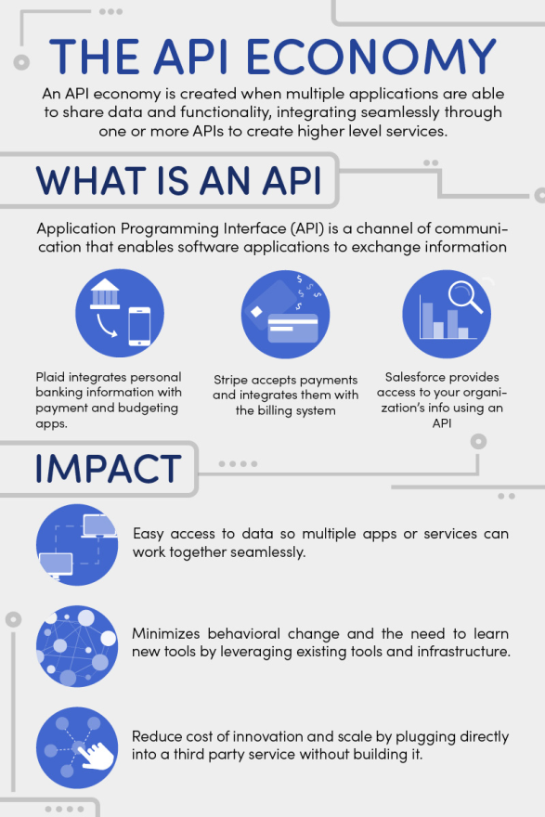
Sidebar: Application Programming Interface
Paul’s definition: Set of formal data exchange protocols which define how one software program talks to another software program
API’s “abstract” the use of the software offering the API, allowing the internal operation of the software to remain hidden– that is, knowledge of the internals is not required to use the software
The concept of the API, when extended to computer-to-computer communication, results in the ISO/OSI layer model

Slide 24
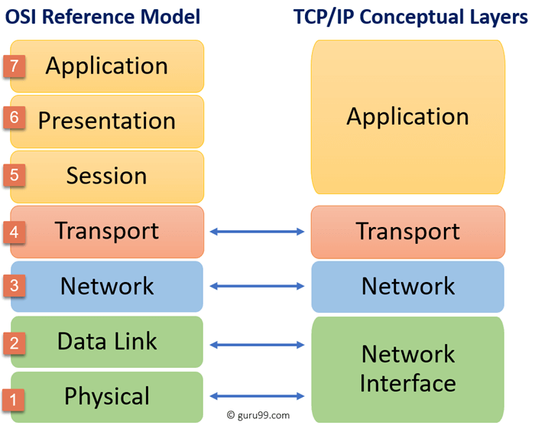
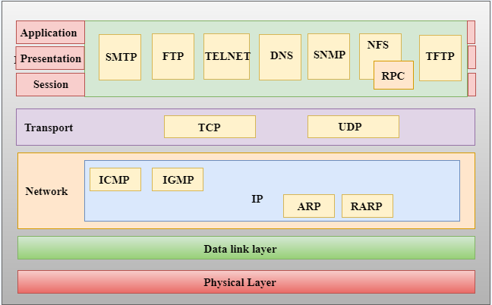
ISO/OSI vs The TCP/IP Model
TCP/IP is the data interchange protocol used by the Internet for computer-to-computer (host-to-host) communications
It only loosely follows the formal OSI/ISO reference model
Many consider TCP/IP to be a separate model, but this is not entirely true
We will not be studying TCP/IP in depth, but it is important to know that it exists and is the underlying protocol used in all web comms
Accurate
Inaccurate

Slide 25
Formal End of Lesson 6
In next week’s exciting episode
Resistors [DMM usage #2]
Diodes and LED’s [DMM usage #3]
Powering LEDs and dropping resistors
Capacitors: Electrolytic (polarized) vs non-electrolytic (non-polarized)
Simplified transistor operation
Connecting an LED to a microcontroller [Class Sketch#1]
Connecting a transistor to a microcontroller [Class Sketch #2]
History of Telecommunications and Networking – Part 3
History of Telecommunications – Part 2
Local Area Networks (LANs)
Wide Area Networks (WANs)
Wireless LAN (WiFi)
Cellular data networks
TCP/IP and the OSI model
The Rise and Fall of the Internet
Don’t forget to return your USB drives!

